Slide 1

2019 Florida Homebrew Club of the Year
March 18th Meeting

Slide 2
Club Motto
Strength Through Unity,
Unity Through Zymurgy

Slide 3



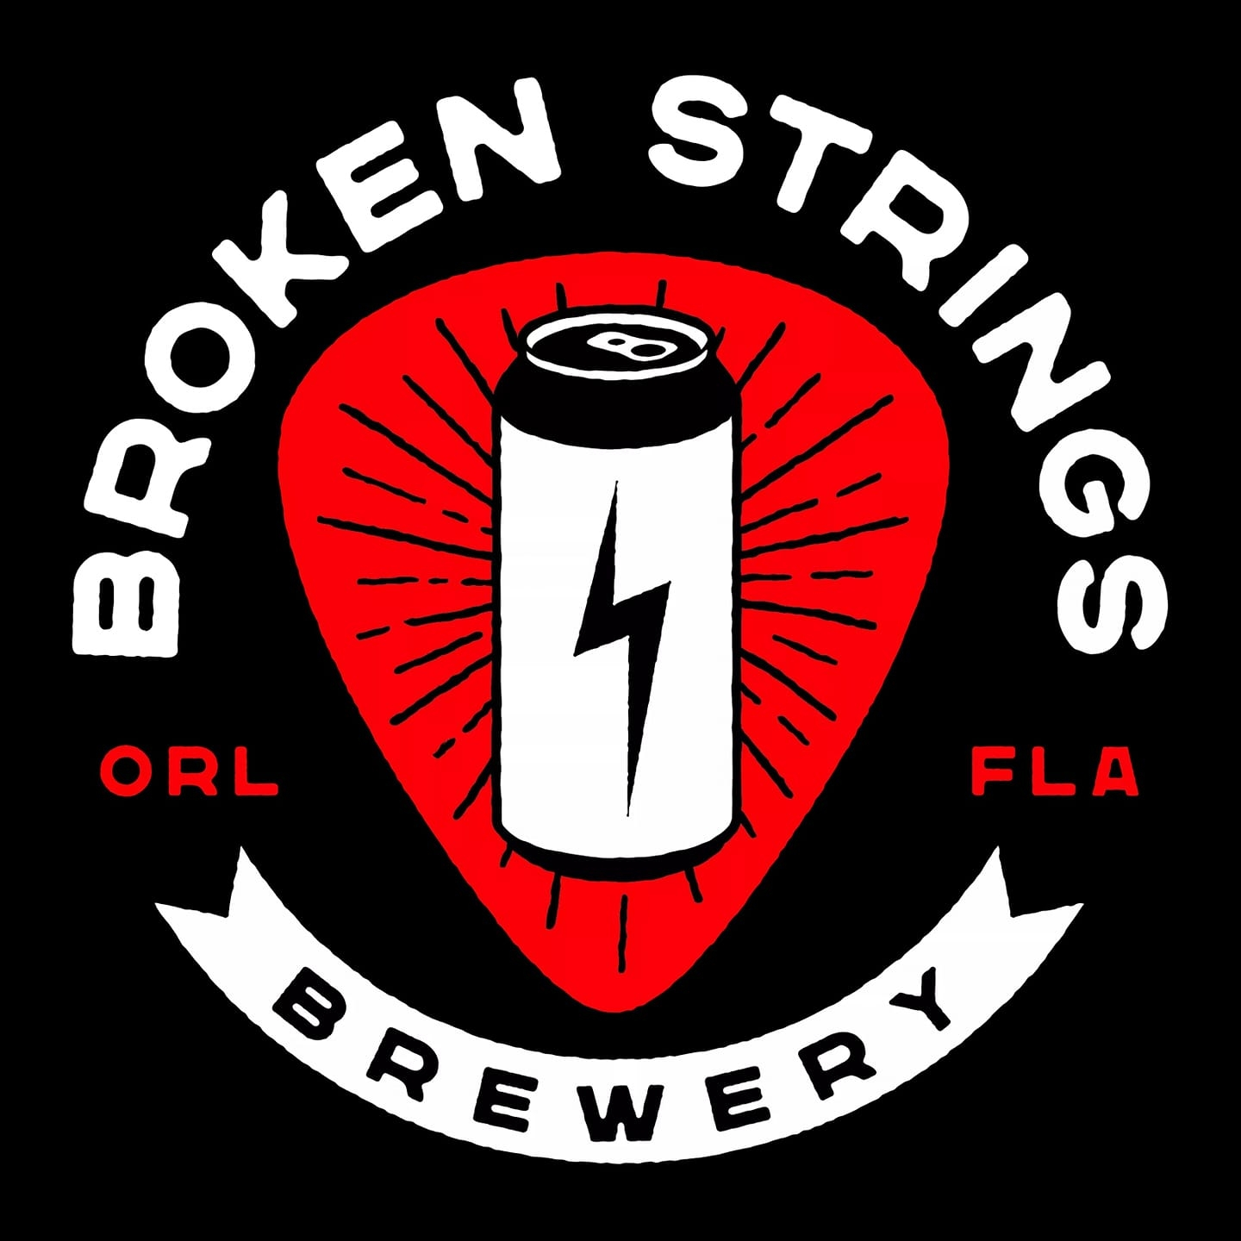


Thank you Supporters!

Slide 4
Welcome New Members!
Jean-Paul Branca
Nathan Recker

Slide 5
2022 Club Challenge Calendar
February: Pilsners
April: Marzen/Festbier
June: Philly Sour (Yeast)
August: Budget Beer
October: Fall Flavors
December: Imperial Stout

Slide 6
April Club Competition
The next club comp is Marzen/Festbier!
All entries must have proper labels printed and attached to the entries to be accepted. The shop will not be able to print out labels for you. If you need any assistance getting your labels printed let us know and we will see what we can do.
Only 1 bottle required
Styles to be accepted:
4b Festbier
6a Märzen
Registration Closes: April 3rd
Entries Due By: April 10th

Slide 7
Differences between BJCP 2015 and BJCP 2021
Gose moves from Historical to European Sour
Kellerbier moved into Historical
  Now covers: Pils, Helles, Amber, and Dark Versions
Grape Ale added to Fruit Beer
  Though this is separate from Italian Grape Ale
Trappist Ale Category is now Monastic Ale
  Trappist Single is now Belgian Single
Clone Beer is now Commercial Specialty Beer
New England IPA is now Hazy IPA
Brut IPA added to specialty IPA category.

Slide 8
2022 Brewer of the Year Standings
Chris H. | 6
Ken M. | 4
Mike T. | 3

Slide 9
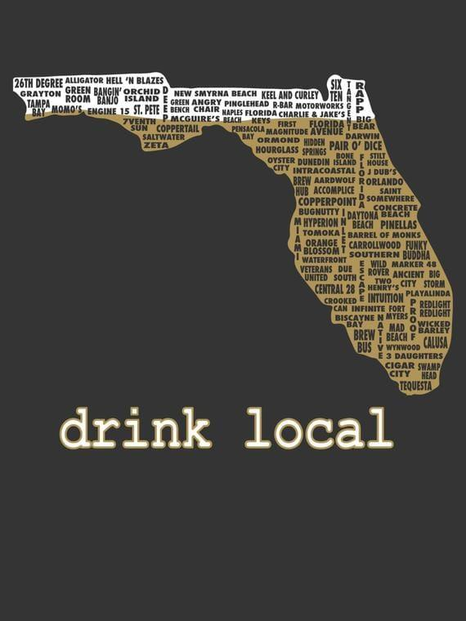
Local Brewery Exploration - Deadwords
1st Friday of each month we will select a local brewery to explore. Come out and share a pint with us as we get to know the breweries in our own backyard.
April 1st @6:30pm
Deadwords

Slide 10

Hurricane Blowoff 2022
Entry Limit: 165
3 Entries Per Brewer
3 bottles per Entry
Registration Opens
FULL!
Train Leaves
March 19th @ 7pm (tomorrow)
Award Ceremony
April 23rd

Slide 11
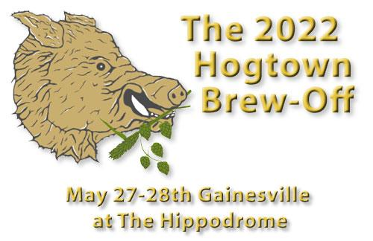
Hogtown Brew-Off 2022
Entry Limit: 326
3 Entries Per Brewer
3 bottles per Entry
Registration Opens
FULL!
Train Leaves
Sunday April 24th
Award Ceremony
May 28th

Slide 12
IPA Smackdown
3 bottles per Entry
Registration Opens
Jan 21st
Entries Due
Apr 18th
Award Ceremony
May 20th

Slide 13

Hot ‘N Humid 2022
Entry Limit: 300
3 Entries Per Brewer
3 bottles per Entry
Registration Opens
April 1st
Entries Due
May 13th
Award Ceremony
June 11th

Slide 14

First Coast Cup 2022
Entry Limit: 300?
3 Entries Per Brewer?
3 bottles per Entry
Registration Opens
May 23rd
Entries Due
June 16th
Award Ceremony
July 16th

Slide 15

Sunshine Challenge 2022
Entry Limit: 400
3 Entries Per Brewer
4 bottles per Entry
Registration Opens
July 18th
Entries Due
Aug 13th
Award Ceremony
Sept 17th

Slide 16
2022 Chair Positions
Non-Elected Chair positions:
BJCP Chair - Chris H.
Competition - Chris T-R and Mark S.
Festival - Looking for a new Chair
Social Media - Jordyn and Sean
Video Content Chair - Leanna C.
Charity Coordinator - Clint S.

Slide 17
Upcoming Events
Hot N Humid Registration Opens: April 1st
Local Brewery Exploration - Apr 1st @6:30pm
April Club Meeting: Apr 15th @ 7:00pm
April Club Comp Entry Closes: Apr 3rd
April Club Comp Delivery Date: Apr 10th
IPA Smackdown Entries due: Apr 18th
Hurricane Blowoff Awards: Apr 23rd
Hogtown Train Leaves: Apr 24th

Slide 18
2019 Florida Homebrew Club of the Year
Thank You!
Next Up: Brew School
Chocolate Grains

Slide 19
Brew School: Brewing Competition Beers
Are you interested in entering competitions, but don’t know where to start?
A competition beer has three primary characteristics:
No detectable flaws
Closely meets style guidelines
Is an enjoyable beer

Slide 20
Brewing Competition Beers: No Detectable Flaws
If a beer is oxidized, has DMS, diacetyl, chlorophenols, infection, fusel alcohols, etc. judges will likely notice and score it poorly
If your beers often have these flaws, focus on eliminating those flaws.
Look through your entire process:
  Are you using good water?
  Are you hitting the right mash temps, sparging at a reasonable temp and PH, and chilling quickly?
  Is your cleaning and sanitization thorough enough?
  Are you pitching the right amount of healthy yeast at the right temp with sufficient oxygen?
Ask for help! You’re not the only one who has gone through this

Slide 21
Brewing Competition Beers: True to Style
Judges aren’t just determining if your beer is tasty, they’re determining if it closely matches the style guidelines
This is often the most difficult thing to nail down, plus judges can be inconsistent
Start by reading the BJCP guidelines for the style
  Pay close attention to the descriptors
  Every attribute is described in detail with an expected range
Judges should be describing your beer in these same terms, then comparing against the style guidelines
Brewing Classic Styles and AHA are a good starting point

Slide 22
Brewing Competition Beers: True to Style
Example:
Aroma: Moderate malty-sweet to malty-rich aroma with chocolate, caramel, nutty, and/or toasty qualities. Hop aroma is typically low to moderate, of almost any variety that complements the malt. Some interpretations of the style may feature a stronger hop aroma, an American or New World hop character (citrusy, fruity, tropical, etc.), and/or a fresh dryhopped
aroma (all are optional). Fruity esters are moderate to
very low. The dark malt character is more robust than other brown ales, yet stops short of being overly porter-like. The malt and hops are generally balanced.

Slide 23
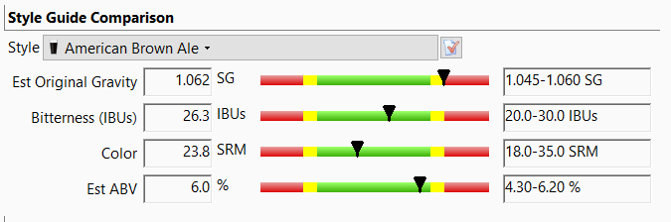
Brewing Competition Beers: True to Style

Slide 24
Brewing Competition Beers: Parting Thoughts
Competitions are a different challenge: you’re not just making a good beer, but you’re making a well-executed beer that’s true to style
The feedback you’ll get from judges should help you to identify improvement opportunities
Plan ahead: trains often leave a week before the due date
Drink the beers that BJCP lists as classic representations of the style to see how yours compare
Share your beers with club members to see if you’re entering as the right style; styles overlap, and you may have tried to make a helles but it tastes more like a german pils

