Slide 1
2019 Florida Homebrew Club of the Year
August 20th Meeting

Slide 2
Club Motto
Strength Through Unity,
Unity Through Zymurgy

Slide 3
Thank you Supporters!

Slide 4
2021 Membership Drive
The 2021 Membership Drive is now underway!
Don’t forget to renew your membership for 2021 for only $24!

Slide 5
August Club Comp Results (Budget Beer)
1st
Ross W. ($19.93)
2nd
Max F. ($14.07)
3rd
Gary F. ($18.22)

Slide 6
2021 Club Challenge Calendar
February: Kviek
April: Brown/Amber
June: Coconut and or Fruit Beers
August: Budget Beer
October: Dark European Lager
December: Barleywine

Slide 7
October Club Competition
The next club comp is Dark European Lager! All entries must have proper labels printed and attached to the entries to be accepted. The shop will not be able to print out labels for you. If you need any assistance getting your labels printed let us know and we will see what we can do.
Styles to be accepted:
8a Munich Dunkel
8b Schwarzbier
All styles accepted.
Registration Closes: October 3rd Entries Due By: October 10th

Slide 8
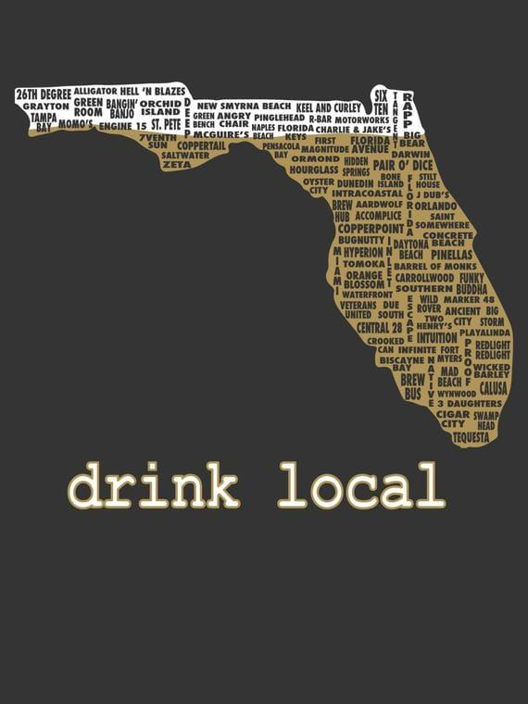
Local Brewery Exploration - Sideward Brewing
1st Friday of each month we will select a local brewery to explore. Come out and share a pint with us as we get to know the breweries in our own backyard. September 3rd @6:30pm
Sideward Brewing

Slide 9
First Coast Cup 2021
Circuit Competition
Jacksonville, FL
Medals available in the shop!

Slide 10
Hot ‘N Humid 2021
Non-Circuit Competition
Orlando, FL
Award Ceremony
Sat Aug 28th @1pm

Slide 11
Sunshine Challenge 2021
Orlando, FL
Award Ceremony
Sat Sept 11th

Slide 12
Oktoberfest in October 2021
Safety Harbor, FL
Registration is now open Most lager styles are accepted, not just Festbier!
Entries due at OHBS by Sept 8th For the train
3 bottles per entry

Slide 13
Comp de L’Abbaye Normale
Jacksonville, FL
Registration opens August 27th All belgian styles accepted
Entries due by Sept 10th Train conductor needed
3 bottles per entry

Slide 14
Fantasy Brew-Off!
Draft is next Friday, August 27th
7pm at OHBS
Beers due for Judging in November
Play as an individual or as a Team
Max 10 Teams
Sign up now!
Judging will be a beauty contest looking for the best tasting beer with a few key elements.
Overall enjoyment
Technical execution
Creativity
USe of Ingredients
Roster (Recipe)
Base Malt
Specialty Malt
Hop
Adjunct
Yeast
Flex (1 of the following)
Specialty Malt
Adjunct
Hop

Slide 15
12 Days of Christmas
Last year we did 24 days of Christmas and it was a blast!
As much fun as it was, 24 beers in a month was a lot to keep up with
This year we are opting for a more manageable “12 Days of Christmas”
If there is interest for multiple 12 days of Christmas we will do as many as we can fill up. Entries will be randomly split amongst each set of 12.
Each participant will need to provide 12 bottles/cans of their submission.
All details will need to be submitted with the entries:
Beer Name
ABV
Style
Possible Allergens

Slide 16
Interested in getting more involved?!
If you are interested in participating as a chairperson for any of the chairs or have an idea for something to help the club please don't hesitate to reach out to me and lets get you involved! Email me at Chris@brewersAnonymous.org

Slide 17
Upcoming Events
Fantasy Brew-Off Draft Night: Aug 27th
Hot ‘N Humid Award Ceremony: Aug 28th
Local Brewery Exploration - Sept 3rd @6:30pm
Club Meeting: Sept 17th @ 7:00pm

Slide 18
2019 Florida Homebrew Club of the Year
Thank You!

