Slide 1
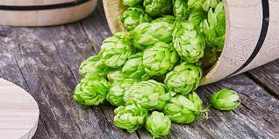
Calypso Hops
Hopsteiner Experimental Hop #03129

Slide 2
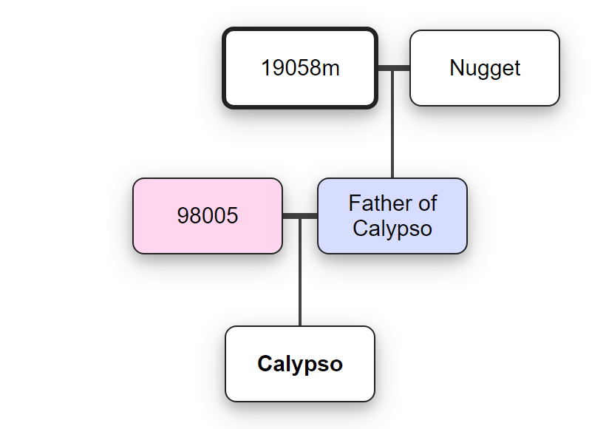
Origins of this hop
US Grown.
A diploid aroma-type hop, originated from a cross between
Hopsteiner breeding female 98005 and a Hopsteiner male derived from Nugget and USDA 19058m.

Slide 3
How to use this hop
Dual Purpose: Bittering and Aroma
High Alpha Acid make it a great bittering hop
Strong Citrus and Tropical Fruit notes make it an excellent aroma addition.

Slide 4
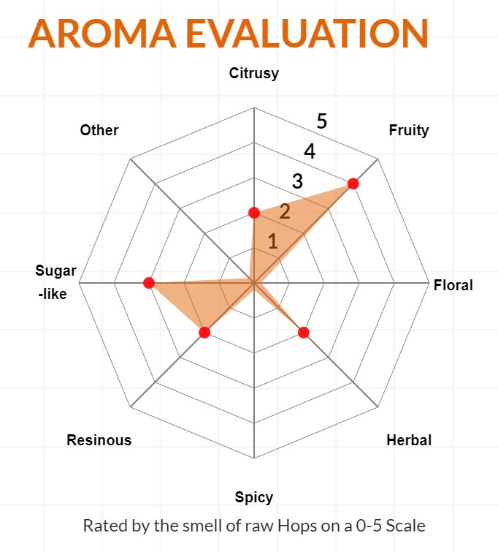
Flavors
Calypso is often described as having a pleasant and complex mix of fruity and citrus-like elements.
Notes can include apple, sappy pear, tropical fruit and stone fruit with the added zippy hints of lemon and lime;
all washed with the subtle shadowed whispers of tea-like earthiness, black-pepper, and mint.

Slide 5
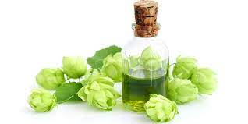
Statistics for this hop
Alpha Acid Range: 13 – 16%
Beta Acid Range: 5.0 - 6.0%
Co-Humulone as % of alpha: 38 - 42
Total oils mL/100 gr.: 1.5 - 2.5
Myrcene: 30 - 45%
Humulene: 20 - 35%
Caryophyllene: 9 - 15%
B-Pinene: 0.5 - 1.0%
Linalool: 0.3 - 0.5%

Slide 6
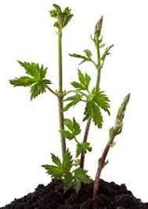
Growing this hop
Growth Rate — Vigorous
Yield — 2,500 – 2,700 lbs/acre
Cones — Very large; compact
Maturity — Early to Mid
Susceptible to — Still being researched
Resistant to — Powdery Mildew; Appears to be tolerate to Verticillium wilt, Very tolerate to Downy Mildew.
Ease of Harvest — Easy; cones detach easily and do not shatter.
Storage — Moderate; Maintains 65% to 70% alpha acid content after 6 months storage at 68°F.
Unfortunately Rhizomes are not available at this time. Substitutes:
Galena
Cascade

Slide 7
Sources
https://learn.kegerator.com/calypso-hops/
https://www.hopsteiner.com/variety-data-sheets/Calypso

