Slide 1
2019 Florida Homebrew Club of the Year
March 19th Meeting

Slide 2
Club Motto
Strength Through Unity,
Unity Through Zymurgy

Slide 3
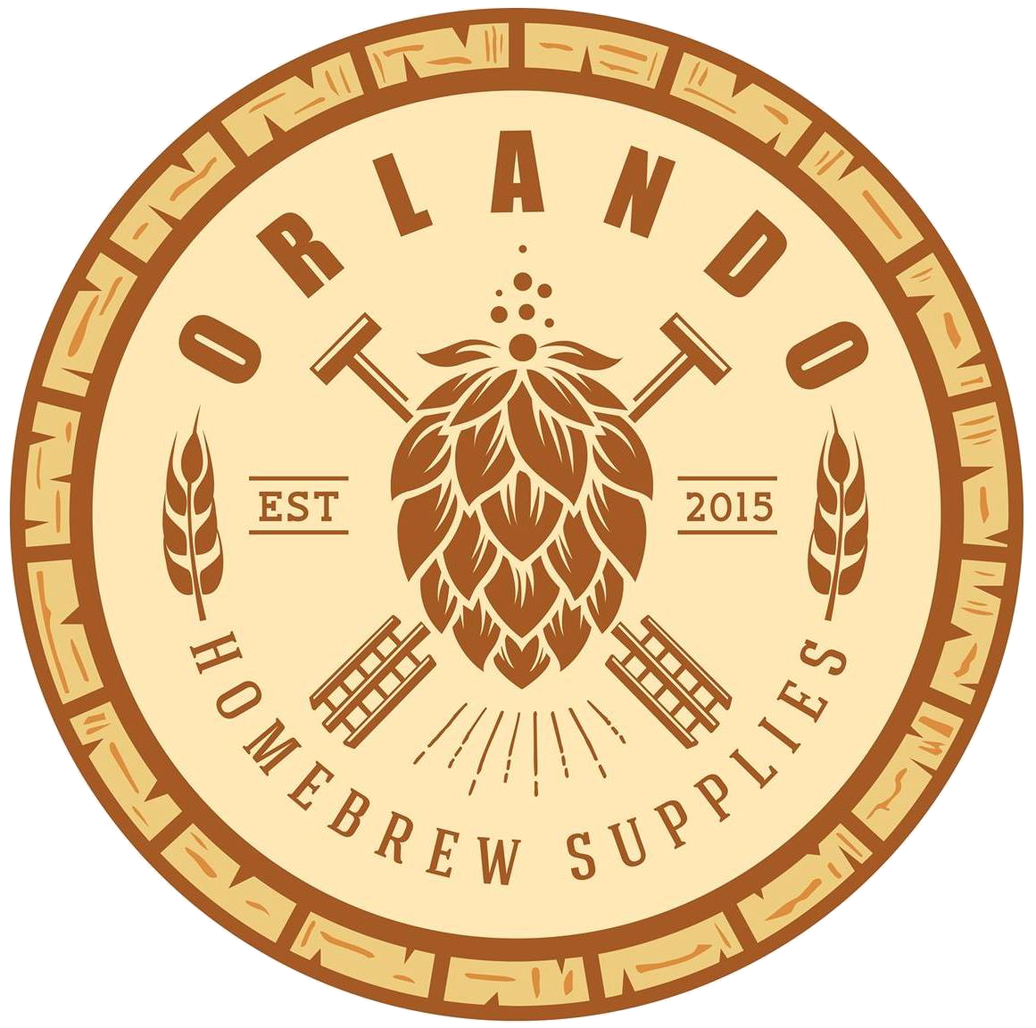
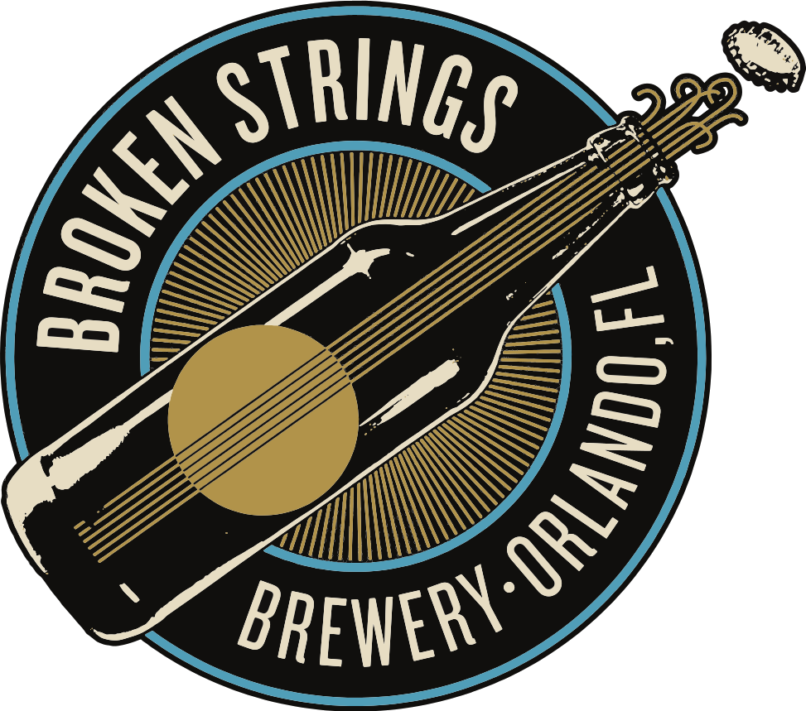
Thank you Supporters!

Slide 4
2021 Membership Drive
The 2021 Membership Drive is now underway!
Don’t forget to renew your membership for 2021 for only $36!

Slide 5
Welcome New Members!
Kenneth Frye
Elliot Taylor

Slide 6
2021 Club Challenge Calendar
February: Kviek
April: Brown/Amber
June: Coconut and or Fruit Beers
August: Budget Beer
October: European Dark Lager
December: Barleywine

Slide 7
April Club Competition
The second club comp is Amber and Brown Ales.
All entries must have proper labels printed and attached to the entries to be accepted. The shop will not be able to print out labels for you. If you need any assistance getting your labels printed let us know and we will see what we can do.
Styles to be accepted:
13A Dark Mild
13B English Brown Ale
13C English Porter
19A American Amber Ale
19B California Common
19C American Brown Ale
Entries Due By: April11th

Slide 8
April Club Comp Judges!
If you would rather be a judge, you can register on the website as a judge.
You don't even need to be BJCP certified.
These club comps are a great way to get experience with the judging process if you are interested.

Slide 9
Hurricane Blowoff 2021
Circuit Competition
Palm Beach, FL
Train Leaves Tomorrow!

Slide 10
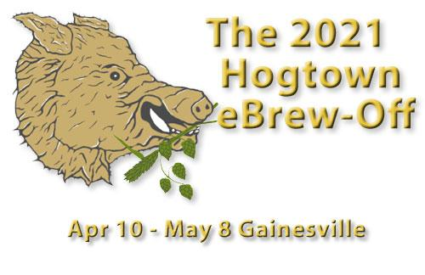
Hogtown eBrew-Off 2021
Circuit Competition
Gainsville, FL
FULL Train leaves next Saturday, March 27th
Beers due at OHBS by
March 26th

Slide 11
Coconut Cup 2021
Circuit Competition
Maimi, FL
Registration begins April 15 Train leaves May 5 Virtual Awards on June 12th Limit 225 Entries!

Slide 12
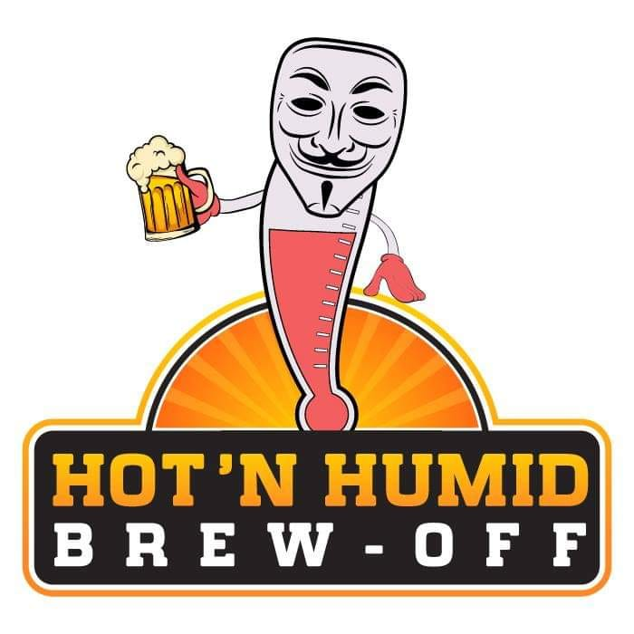
Hot ‘N Humid 2021
Non-Circuit Competition
Orlando, FL
Registration begins
June 26th
4 Bottles per Entry Limit 200 Entries!

Slide 13
What’s my style?!
Thank you to everyone that dropped off their entries for review
Special thank you to:
Clint John S. Gary F

Slide 14
New club challenge beginning next month
Three random ingredients (1 specialty malt, 1 hop, and 1 adjunct) will be selected at random at the April club meeting
Every brewer must then use those ingredients to make a beer of any style. Each ingredient will need to be used at detectable levels
Bring a keg or bottles to share at the June club meeting, where everyone in attendance will get to sample your beers and pick the favorite
Rules and registration link will be posted next week
Enter as an individual or a team. Limited to paying members only

Slide 15
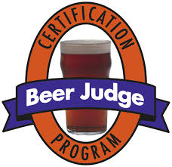
BJCP Training!
When: Mar 22nd @ 7pm
Where: Zoom
Who: anyone interested in learning more about the Beer Judge Certification Program, BJCP and wants to test their knowledge.
What: We're going to do Pub Trivia on Brown and Amber ales! How well do you know them? Study the BJCP guide to prepare!
If you have have any questions feel free to reach out to Gary F.
Also check out our Brewers Anonymous BJCP Training Facebook Group

Slide 16
Interested in getting more involved?!
If you are interested in participating as a chairperson for any of the chairs or have an idea for something to help the club please don't hesitate to reach out to me and lets get you involved! Email me at Chris@brewersAnonymous.org

Slide 17
Upcoming Events
Hurricane Blow-Off Train Leaves: March 20th
BJCP Trivia: March 22nd
Hogtown Brew-Off Train Leaves: March 27th
Club Meeting: April 17th @ 7:00pm

Slide 18
2019 Florida Homebrew Club of the Year
Thank You! Brew School starts in 5 min

Slide 19
March Brew School: Brewing Belgian-style Ales
Agenda
Suggested reading
Dispelling a few myths
Getting the most out of Belgian yeast

Slide 20
Suggested Reading
Stan Hieronymus’s Brew Like a Monk

Slide 21
Dispelling a few Myths: Myth #1
Belgian beers are great if you don’t have temperature control. Especially saisons!
Although some yeast strains perform well in the 70-75f range, Belgian yeasts still benefit from having a steady and consistent temperature
Some saison strains perform well in the 80s if you’re okay with bubble gum esters
Cleaner or milder yeast characteristics require typical ale temperatures
Many breweries also ramp up the fermentation temperature over time, which requires a certain degree of control

Slide 22
Dispelling a few Myths: Myth #2
Brewing Belgian beers requires performing a step mash
Some Belgian breweries performed protein rests historically, but as maltsters have improved the modification of grains, it’s no longer necessary
Some may still perform a step mash, but it’s more likely due to habit and not necessity
If you are using a large amount of unmalted grains, a protein rest could be useful, otherwise a single temp mash is fine

Slide 23
Dispelling a few Myths: Myth #3
You should underpitch to stress the yeast and get more flavor
Underpitching may give more off-flavors and solvent-y higher alcohols, but for Belgian yeasts they produce enough esters without needing to stress them
Additionally, research has found that longer growth phases for yeast actually limit the amount of esters being produced
Most Belgian breweries pitch fairly typical rates .75-1m cells per ml/Plato
You can produce more esters by not oxygenating wort. As long as there is still sufficient nutrients in the wort, yeast will begin producing more esters once all oxygen has been absorbed

Slide 24
Dispelling a few Myths: #4
Belgian beers should include only Belgian ingredients
Although using Belgian ingredients may feel more authentic, you’re brewing a Belgian-style beer and not a Belgian beer unless you’re in Belgium, so instead focus on the style
Traditionally Belgian breweries focused on using local ingredients, so using American grains and hops is acceptable
Belgian candi syrup is a great ingredient and the darker variations provide great depth of flavor, but for pure sugar additions there’s little advantage over invert sugar from sucrose

Slide 25
Dispelling a few Myths: Myth #5
Belgian beers have complex flavors and therefore require complex recipe
Quite the opposite, most Belgian recipes are incredibly simple
Saison Dupont uses only pilsner. Many Trappist beers are pilsner and sugar/starch
Whenever possible, keep your recipe simple: pilsner or 2-row, sugar, a crystal malt or two for darker styles, and maybe an unmalted grain for saisons or tripels
The complexity of flavor comes from the yeast, so make a quality beer and help the yeast do the rest

Slide 26
Getting the most from your yeast
Classic Belgian yeasts provide a balance of spicy, peppery phenols and fruity esters
The Rochefort strain (aka 1762) is unique in that it doesn’t create phenols
The key is to get a good balance between phenols and esters. In my opinion, getting the best balance requires focusing on increasing esters
This can include things like:
Filter your wort to reduce trub. Trub reduces ester production
Pitch a standard amount of yeast, use yeast nutrient, but don’t oxygenate much
Use a large diameter blowoff
If you use spices to complement your yeast, start with small amounts. Spice should be a whisper, not a scream

