Slide 1

2019 Florida Homebrew Club of the Year
February 19th Meeting

Slide 2
Club Motto
Strength Through Unity,
Unity Through Zymurgy

Slide 3







Thank you Supporters!

Slide 4
2021 Membership Drive
The 2021 Membership Drive is now underway!
Don’t forget to renew your membership for 2021 for only $36!

Slide 5
Welcome New Members!
Joe Flattery
Getulio Garcia
Dave Churchill

Slide 6
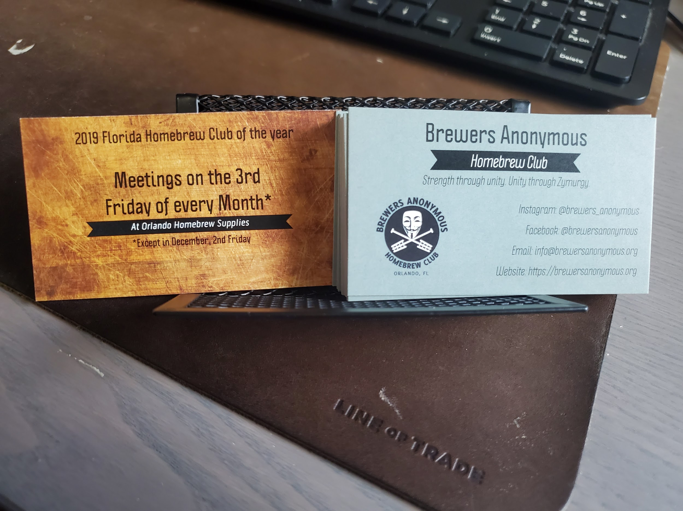
New Business Cards!
Easy to hand out at:
The shop
Festivals
Events

Slide 7
2021 Club Challenge Calendar
February: Kviek
April: Brown/Amber
June: Coconut and or Fruit Beers
August: Budget Beer
October: European Dark Lager
December: Barleywine

Slide 8
Kveik Competition Results coming Soon!

Slide 9

Hurricane Blowoff 2021
Circuit Competition
Palm Beach, FL
Registration begins March 01
Train conductor needed!
Entry Delivery by March 26
Virtual Awards on April 24th
Limit 100 Entries!

Slide 10

Hogtown eBrew-Off 2021
Circuit Competition
Gainsville, FL
Registration begins March 01
Train leaves OHBS on March 26
Entry Delivery by April 02
Virtual Awards on May 8th
Limit 225 Entries!

Slide 11

Coconut Cup 2021
Circuit Competition
Maimi, FL
Registration begins April 15
Entry Delivery by May 6
Virtual Awards on June 12th
Limit 225 Entries!

Slide 12
Special categories and underrepresented
Our Competition chairpeople are working to help you do better in circuit competitions!
Check the Brewers Anonymous FB events for these comps to see the data.
Many styles have very few entries in these competitions, so picking an underrepresented style gives you better odds of winning a medal!
Chairperson: Mark S.
Chairperson: Clint S.

Slide 13
What’s my style?!
When: March 16th
Where: Leave a beer, take a beer Fridge in the OHBS
Warehouse.
Who: Anyone submitting a beer to a comp but not sure what style to submit it as.
What: Drop off TWO bottles of your beer(s) with Your name and what style(s) you were considering submitting it under. Judges will pick those beers up on the 16th and provide feedback as to what category to Submit the beer as.

Slide 14
What charity are you passionate about?
We are partnering with Hops Brew Hope this year to give back more to our community.
Hot N Humid 2021 is looking to partner with a local charity and Hops Brew Hope will help us do that.
Now we want to know what you are passionate about?

Slide 15

BJCP Training!
When: Feb 22nd @ 7pm
Where: Zoom
Who: anyone interested in learning more about the Beer Judge Certification Program, BJCP and wants to test their knowledge.
What: Guided Tasting and Scoresheet practice. Anyone wanting to attend our remote BJCP judging training will need to pick up the following 3 beers:
- Cackler IPA from RockPit Brewing
- Moonboots IPA from Sideward Brewing
- Circa 2000 IPA from Tactical Brewing
If you have have any questions feel free to reach out to Gary F.
Also check out our Brewers Anonymous BJCP Training Facebook Group

Slide 16
New BJCP Judges!
Passed Online Entrance Exam
Congrats to George Black
Passed Tasting Exam:

Slide 17
Interested in getting more involved?!
If you are interested in participating as a chairperson for any of the chairs or have an idea for something to help the club please don't hesitate to reach out to me and lets get you involved!
Email me at Chris@brewersAnonymous.org

Slide 18
Upcoming Events
Club Meeting: March 19th @ 7:00pm
BJCP Guided Tasting: February 22nd
Hurricane Blow-Off Registration Opens: March 1st
Hogtown Brew-Off Registration Opens: March 1st
What’s My Style? (Deadline): March 16th

Slide 19
2019 Florida Homebrew Club of the Year
Thank You!

